Slide 1



LOOK BACK 4
Part 4

Slide 2
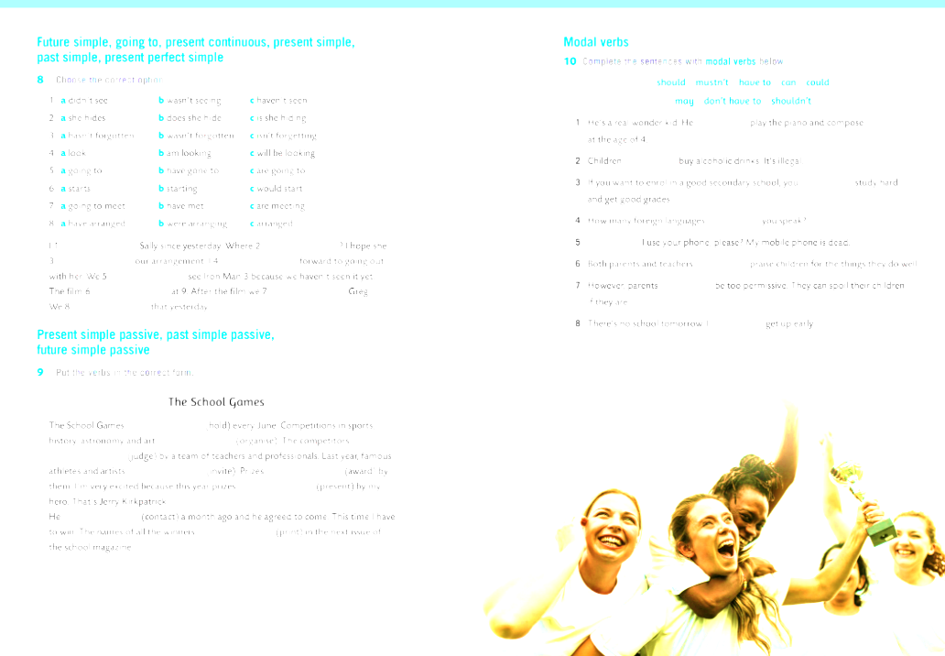

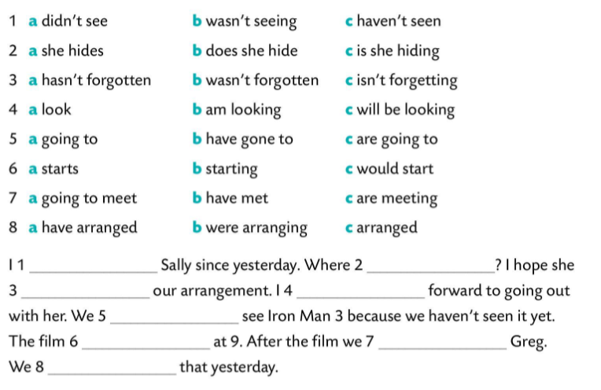
haven’t seen
is she hiding
hasn’t forgotten
am looking
are going to
starts
are meeting
arranged

Slide 3
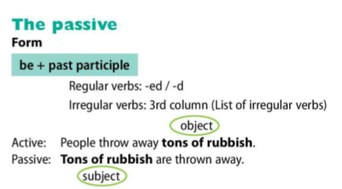
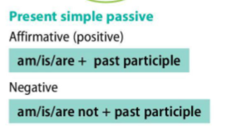
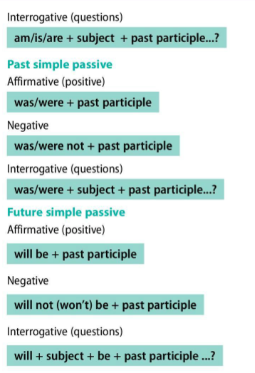

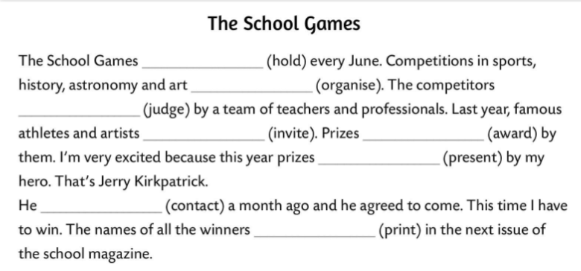
are held
are organized
are judged
were invited
were awarded
will be presented
was contacted
will be printed

Slide 4
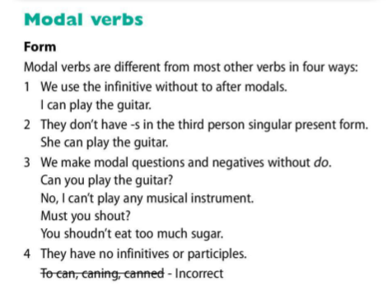
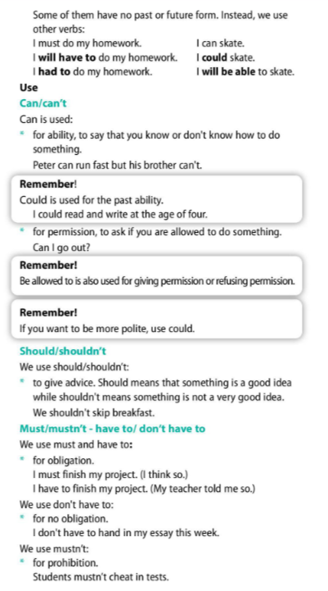
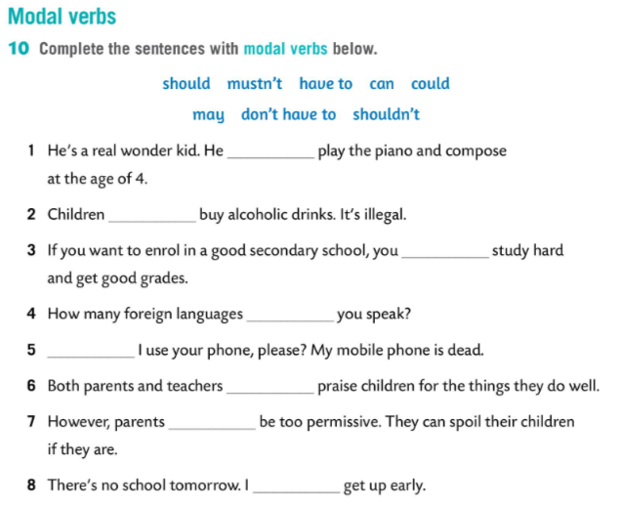
could
mustn’t
have to
can
May
should
shouldn’t
don’t have to

Slide 5
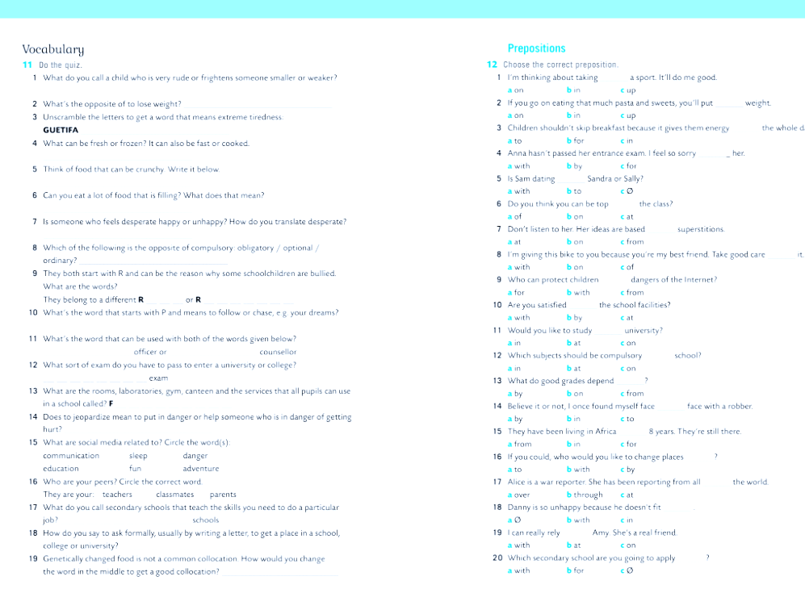

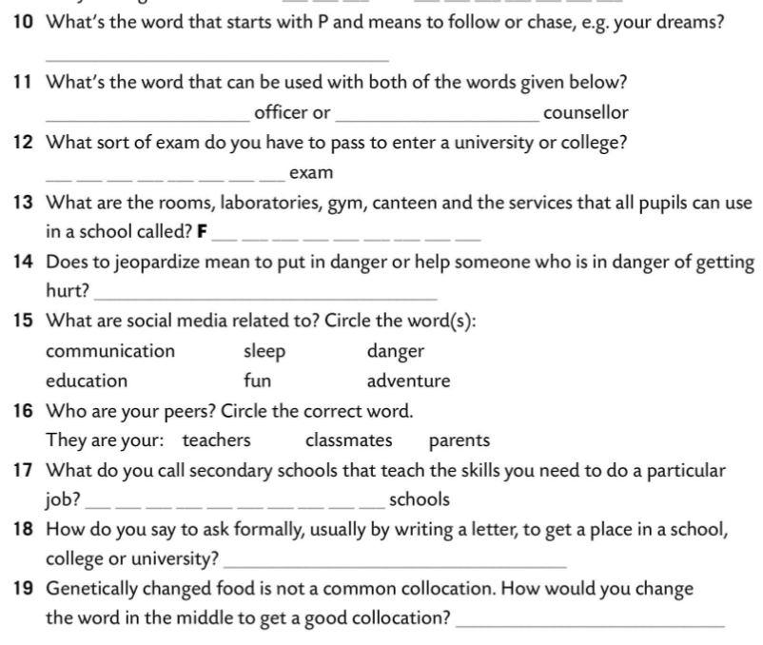
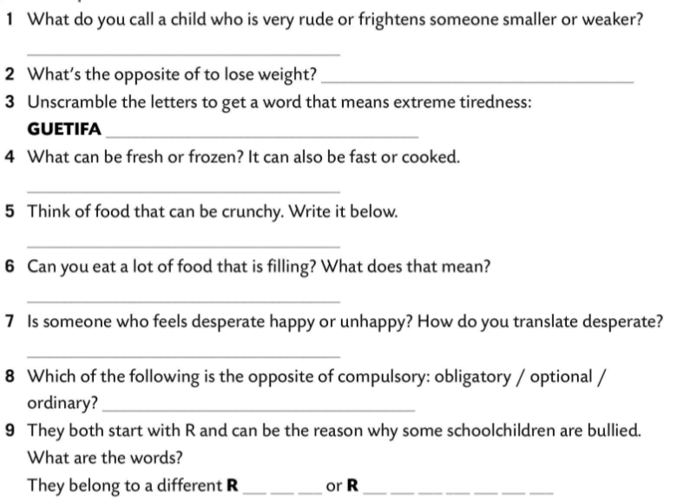
pursue
guidance
guidance
bully
entrance
put on weight
fatigue
ACILITIES
food
To put in danger.
bread
No. It means that it has got a lot of calories.
Unhappy. Očajan.
vocational
optional
to apply
ACE
ELIGION
modified

Slide 6

